Slide 1
School fees Online Payment - OPJS Website
O P JINDAL SCHOOL
PATRATU

Slide 2
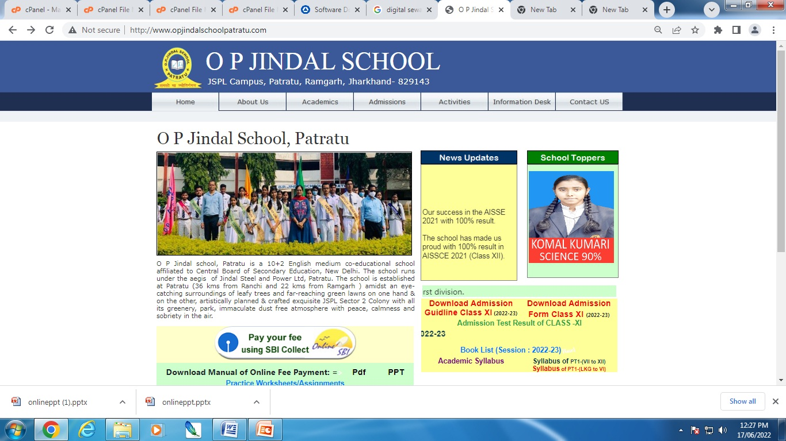
OPJS website link: http://www.opjindalschoolpatratu.com/
Click on “Pay your fee using SBI Collect”
Issue Tracker- Infrastructure Patratu
Incidence
Report
Priority Open Reported Resolved Pending
Low 0 08 08 0
Normal 0 37 37 0
High 0 244 244 0
Urgent 0 70 70 0
Total 0 359 359 0
Click Here
Call Resolution Break-up
Time Frame
Calls
0-2 Hrs
358
2-4 Hrs
0
4-8 Hrs
0
> 8 Hrs
1

Slide 3
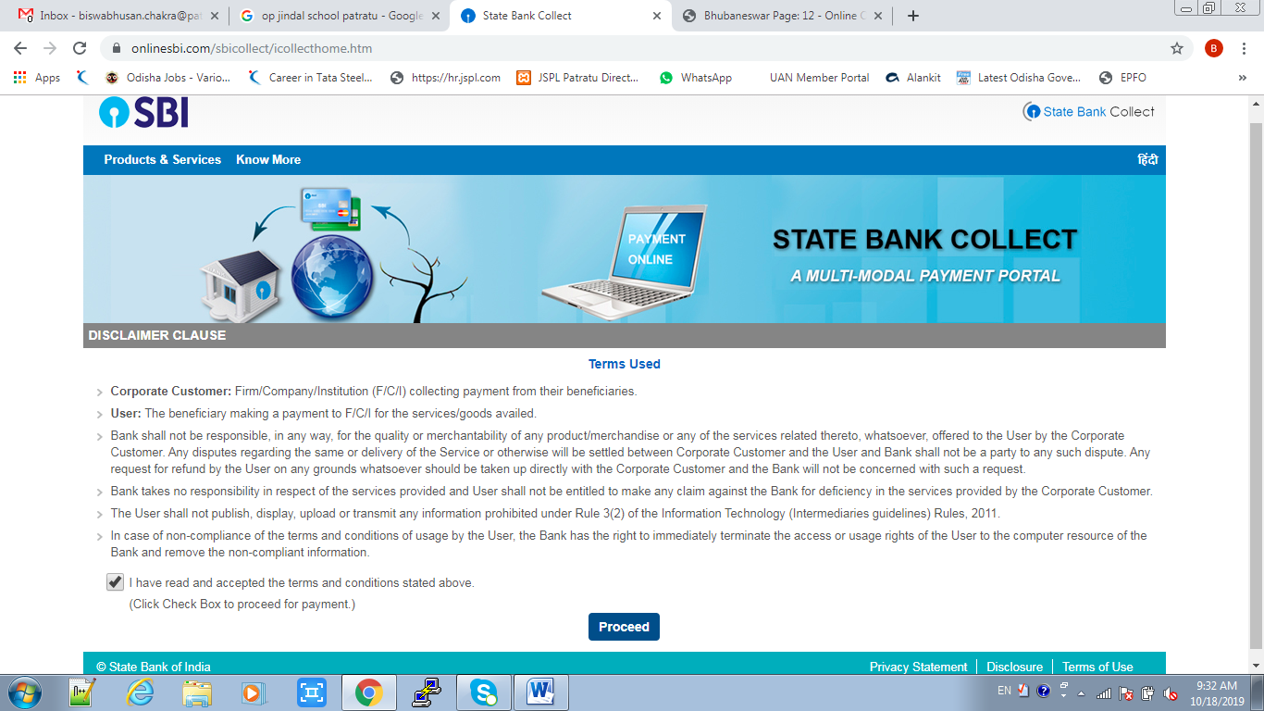
Below screen appears. Click the check box and then click on “Proceed” button.
Particular Open Reported Resolved
Click here
Click here

Slide 4
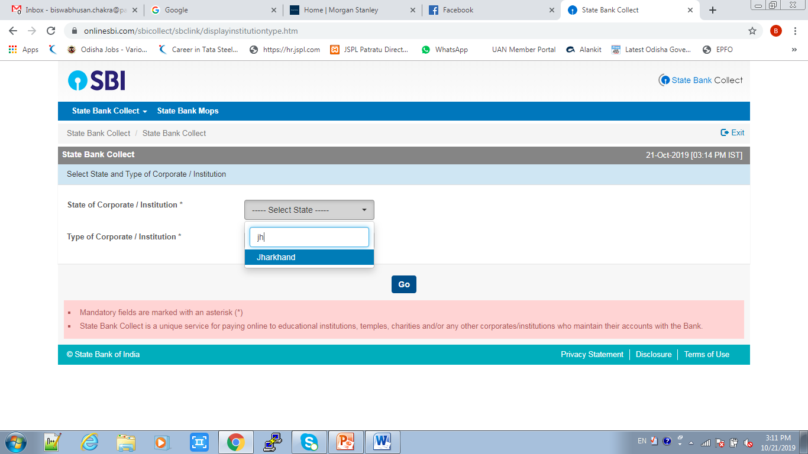
New window opens. Select “State of Corporate / Institution” as Jharkhand from drop down.
Particular Open Reported Resolved
Select State of Corporate/Institution

Slide 5
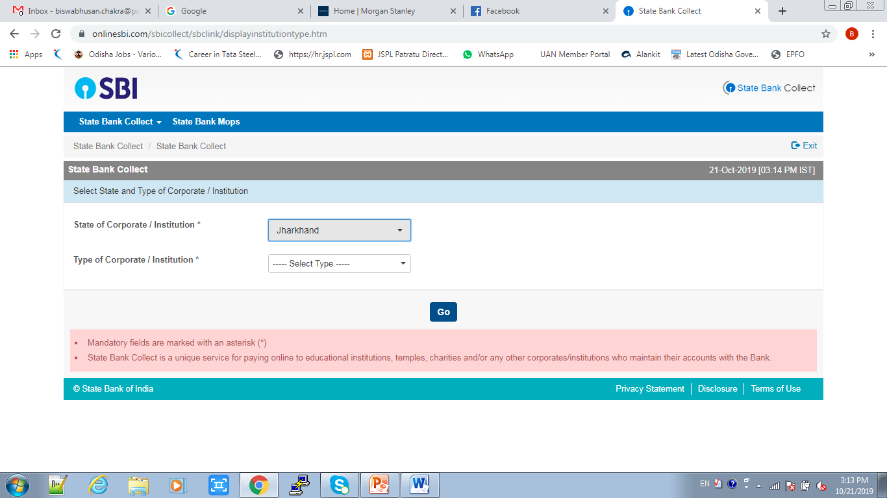
From drop down select the state as Jharkhand in the “State of Corporate / Institution” category.
Particular Open Reported Resolved
Select State as Jharkhand

Slide 6
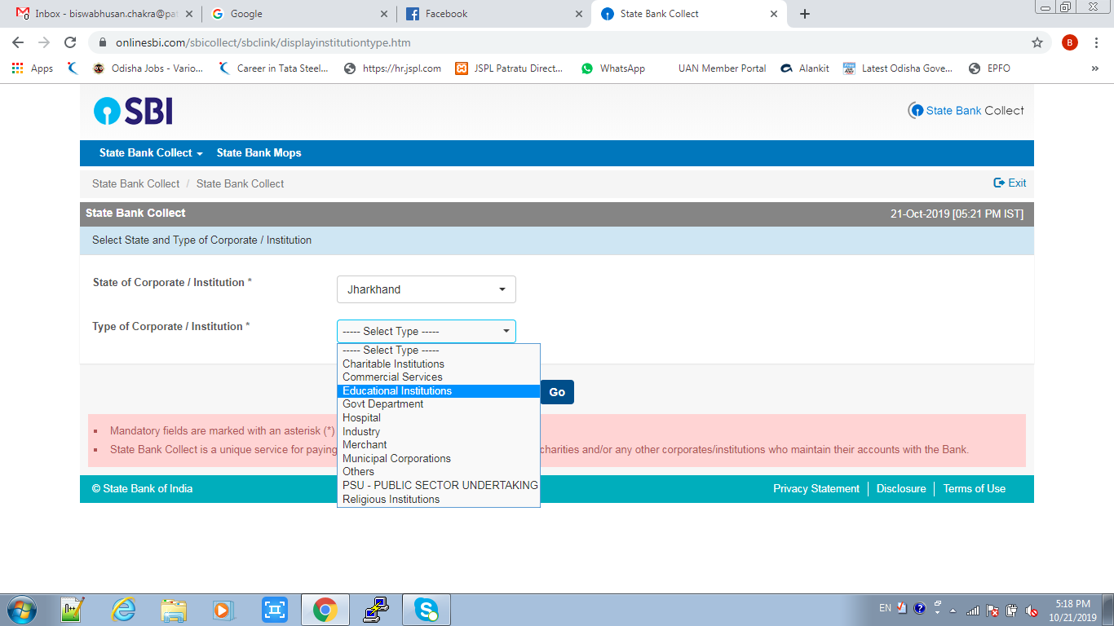
Select “Type of Corporate / Institution” as Educational Institution from drop down.
Educational Institution

Slide 7
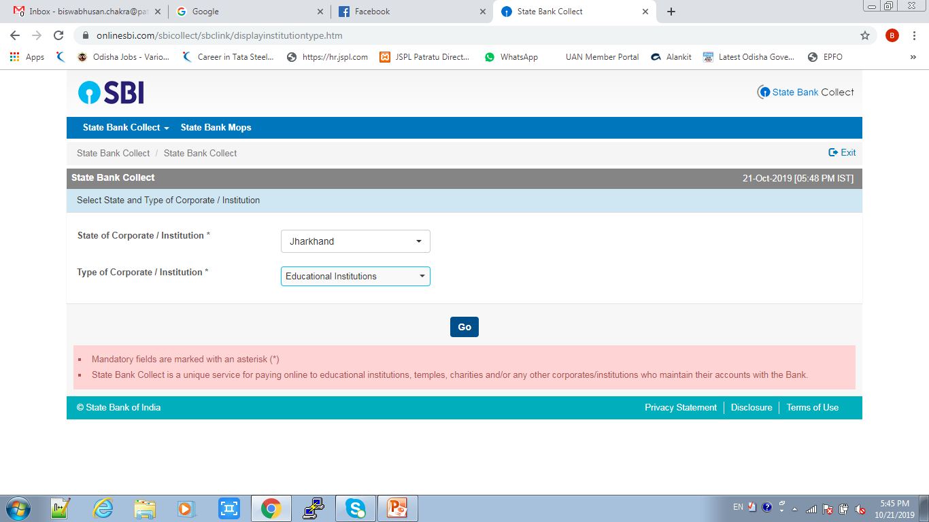
After select “State of Corporate / Institution as Jharkhand” and “Type of Corporate / Institution as Educational Institutions” then click to Go button.
Click Here

Slide 8
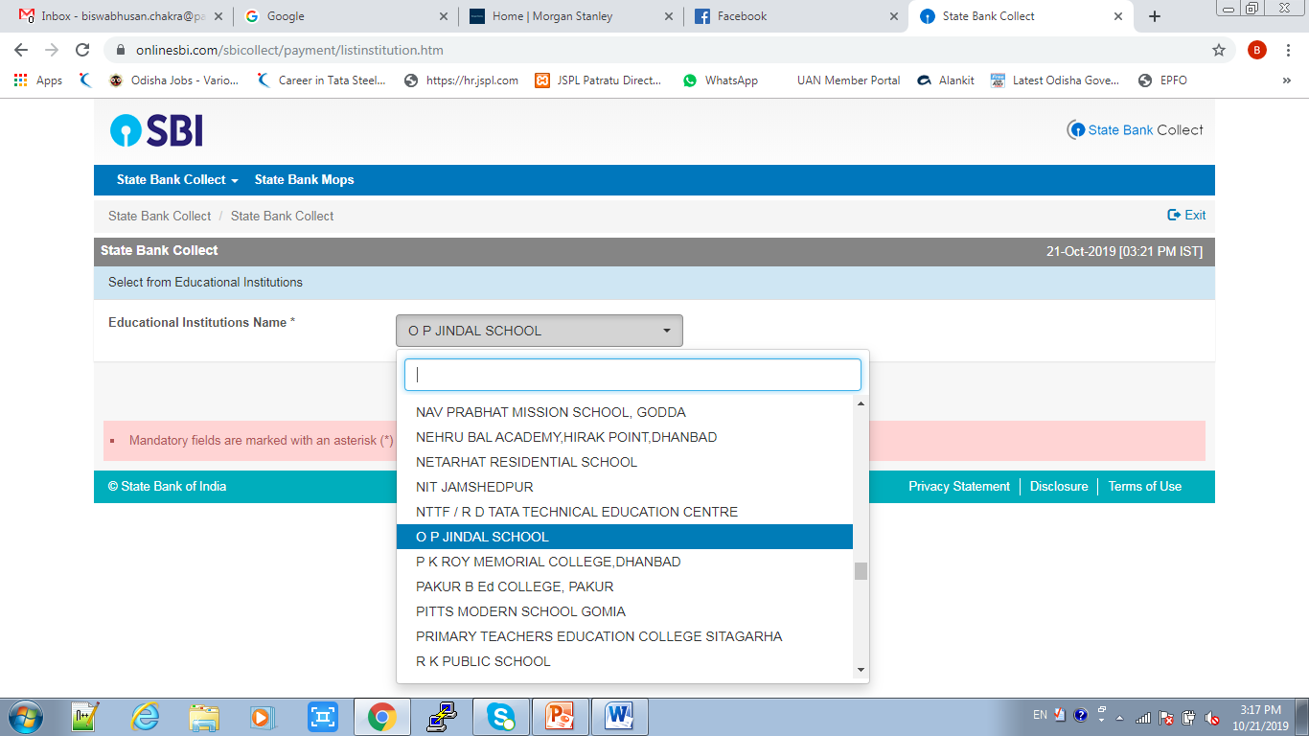
Then Select “Educational Institutions Name” as OP Jindal School as in drop down and click on submit button
Enter Educational Institution Name

Slide 9
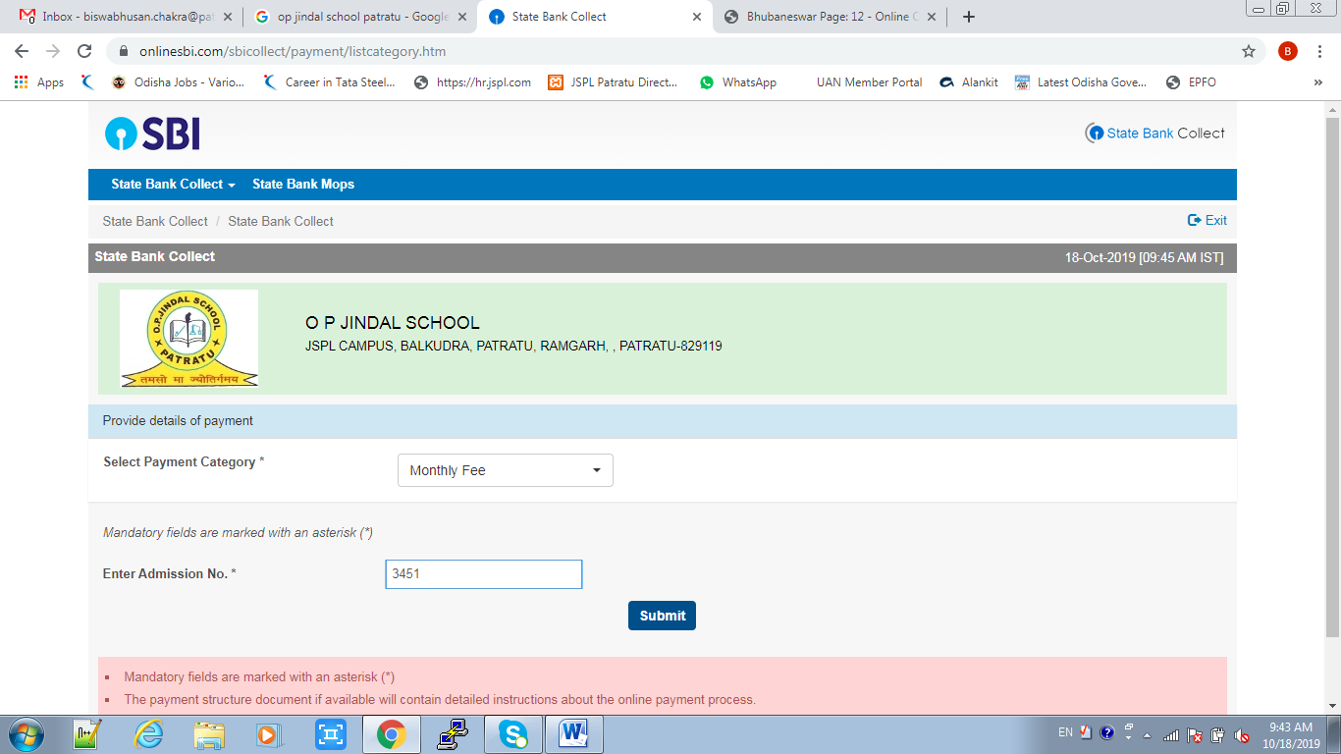
New window opens asking “Payment Category” and “Enter Admission Number” of respective student.
Choose payment category
Enter Admission number of student
Click here

Slide 10
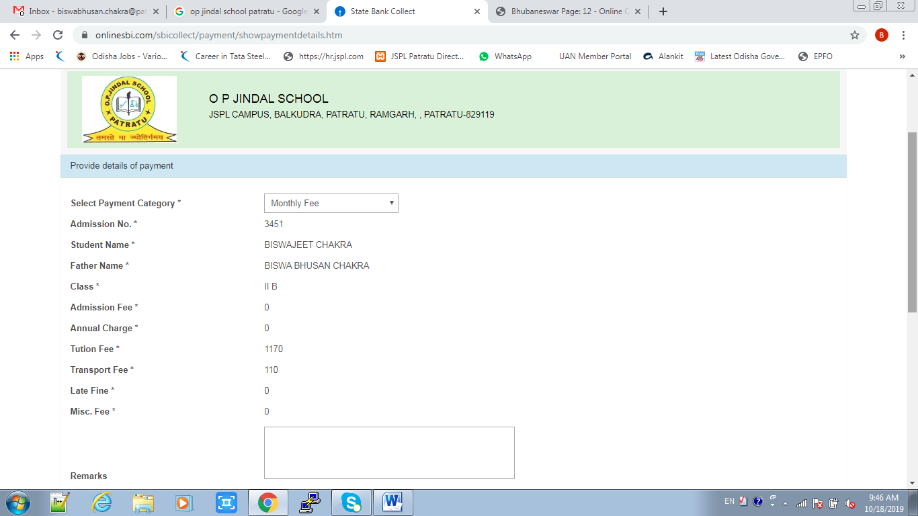
After submission concerned student detail appears. Select payment category and other details like “Name, Date of birth/Incorporation, Mobile Number, E-Mail ID along with text as shown in screen. Remarks field is optional. If required can be filled as per user choice.

Slide 11
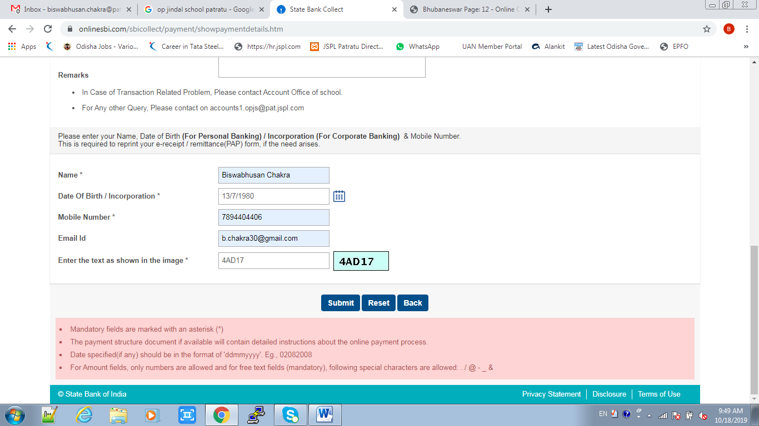
After filling all the details click on “Submit” button to proceed.
Click here

Slide 12
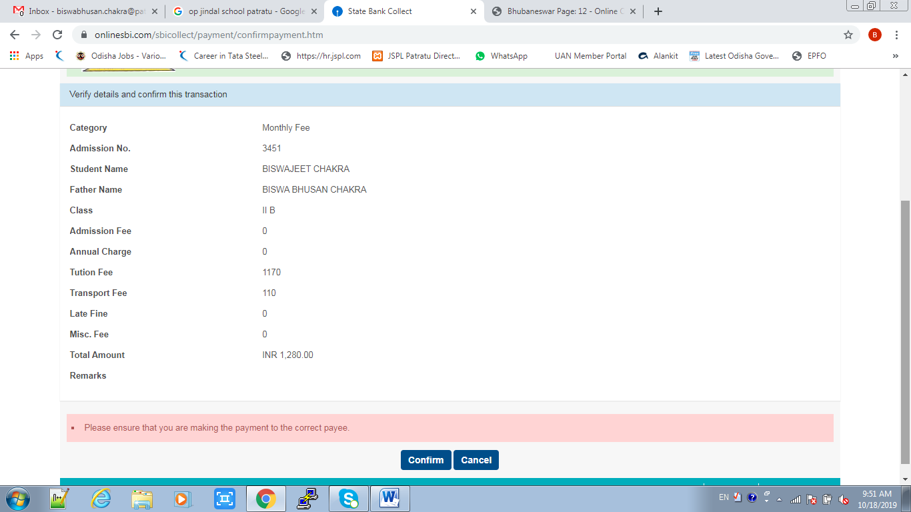
After submission student details will appears for final confirmation. After verifying all the details filled click on confirm button to proceed.
Click here

Slide 13
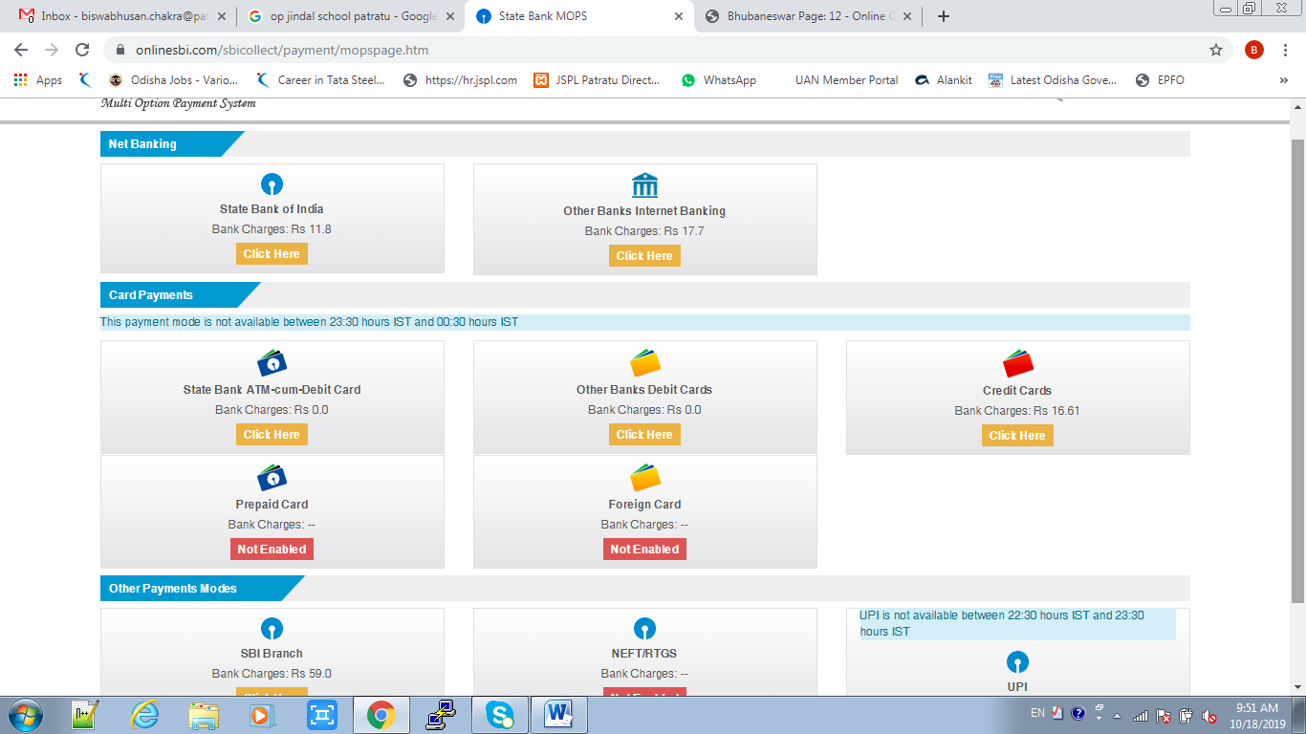
After confirmation new window opens for selection of user choice of payment as net banking, debit card, credit card etc. as shown below. As per user choice new screen will appear for final payment with concerned options.

Slide 14
Thank you
O P JINDAL SCHOOL
PATRATU

